Slide 1
ELECTRONICS RETAIL STORE
REVENUE AND CUSTOMER SEGMENTATION ANALYSIS
Data cleaned in excel – merged in tableau – visualised and analysed in tableau

Slide 2
PROBLEM STATEMENT
Retail businesses generate large amounts of sales and customer data,
but turning this data into actionable insights remains a challenge.
This project analyzes revenue trends, profitability, and customer purchasing behavior for an electronics retail store using Excel and Tableau.
The goal is to identify high-performing products, valuable customer segments, and business
opportunities through interactive dashboards and data-driven insights.

Slide 3
PROJECT METHODOLGY
1.Data collection
Raw sales, customer, product & stores loaded into Excel across 5 worksheets.
Data obtained was fictious data from Maven Analytics.
2. Data cleaning in excel
Removed duplicates, fixed date formats, filled missing values, standardized age to age groups.
3.Data loading in Tableau
Cleaned tables imported into Tableau Desktop as data sources ready for relationship mapping.
4.Table merging in tableau
Tables linked via Relationships: Sales↔Customers (Customer Key), Sales↔Products (Product Key), Sales↔Stores (Store Key).
5. Calculated Fields
Revenue, Profit, RFM Scores, Average order per customer, Average purchase per customer— built as Tableau calculated fields.
6. Dashboard build
Two dashboards: Revenue and Profitability Dashboard + Customer Segmentation Dashboard with Parameters & Sets.

Slide 4
DATA SET STRUCTURE
TABLE | RECORDS | KEY FIELD | PURPOSE
Products | 2517 | Product Key, Brand, Category, Price | Product catalogue with prices
Customers | 15266 | Customer Key, Agegroup, Country, Continent | Customer Demographics
Sales | 62884 | Order No, Customer Key, Product Key | Transaction level data
Stores | 67 | Store Key, Country | Physical Store locations

Slide 5
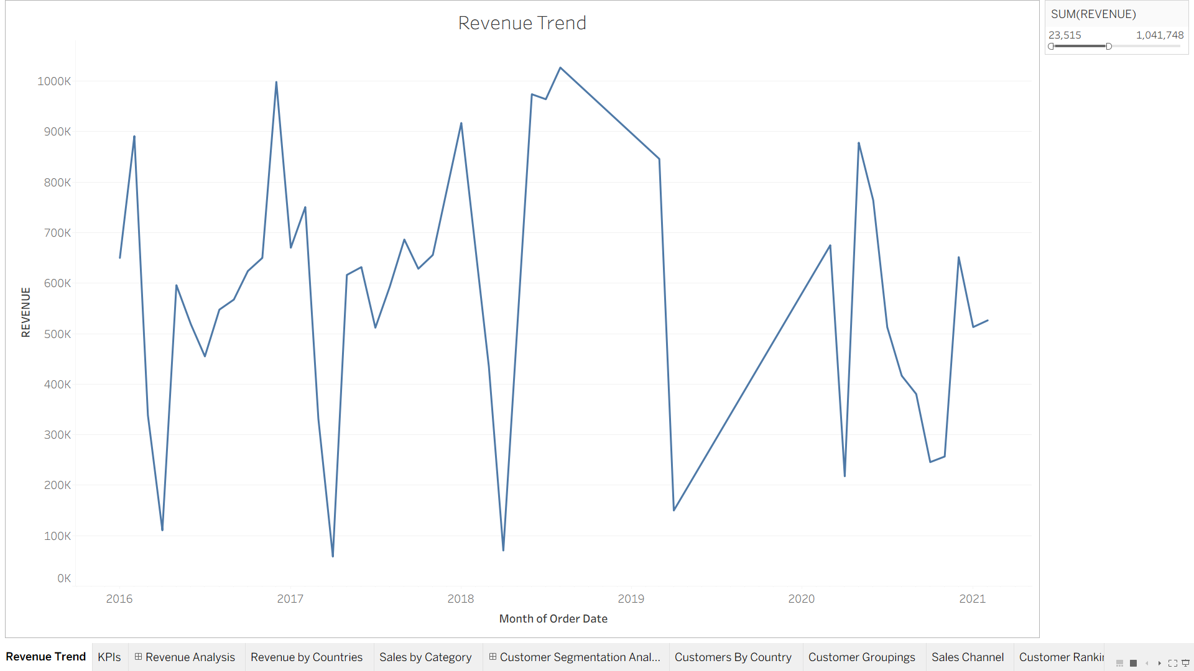
REVENUE AND PROFITABILTY ANALYSIS
KEY FINDINGS
Revenue grew strongly from 2016 to 2019 peaking at and there was also a sharp decline in 2020-2021 which was consistent with pandemic driven retail disruptions

Slide 6
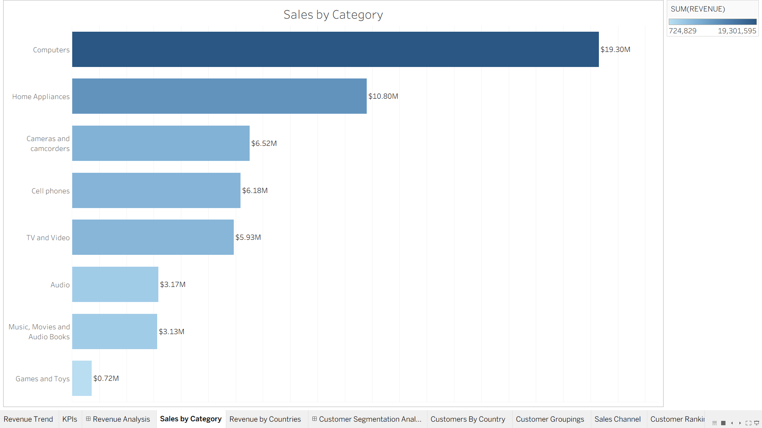
REVENUE AND PROFITABILTY ANALYSIS
KEY FINDINGS
Computers is the largest category both in revenue and profit.

Slide 7
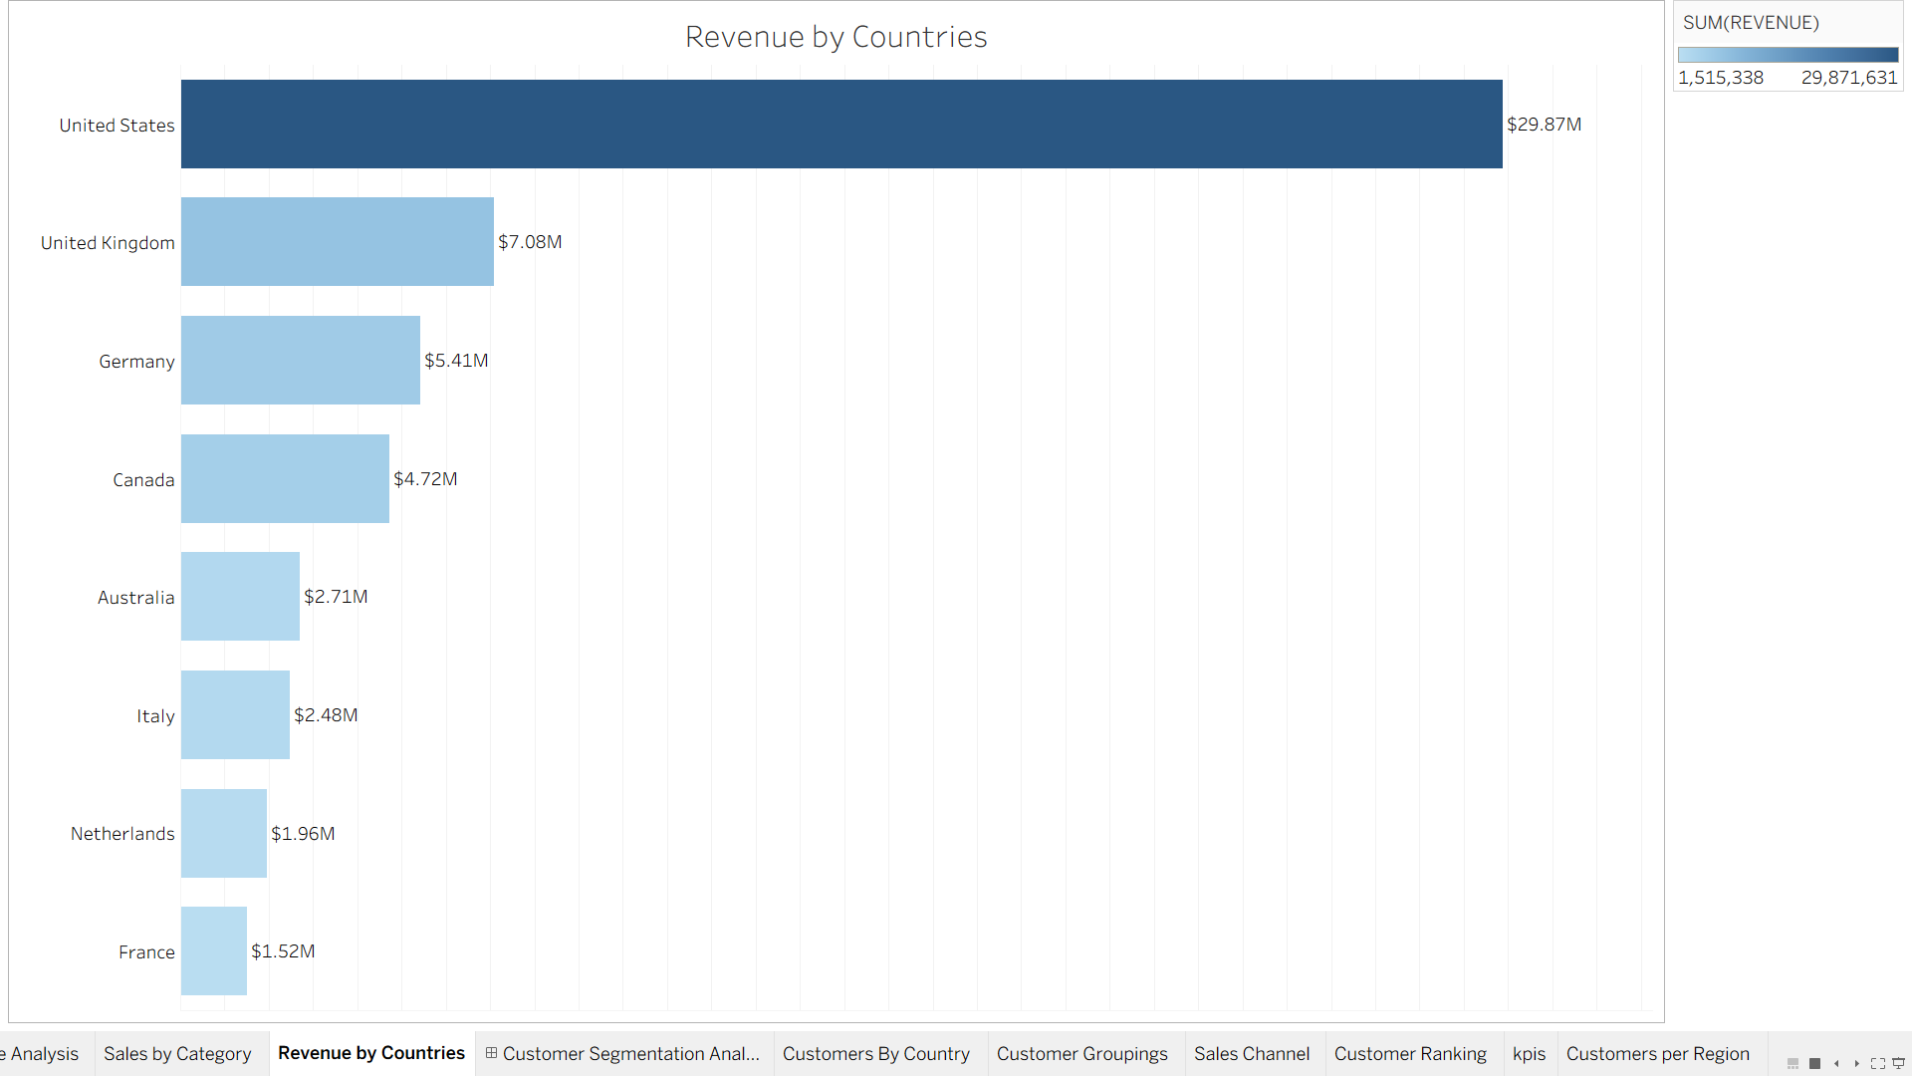
REVENUE AND PROFITABILTY ANALYSIS
KEY FINDINGS
The united states is by far the largest market contributing to almost half of the revenue

Slide 8
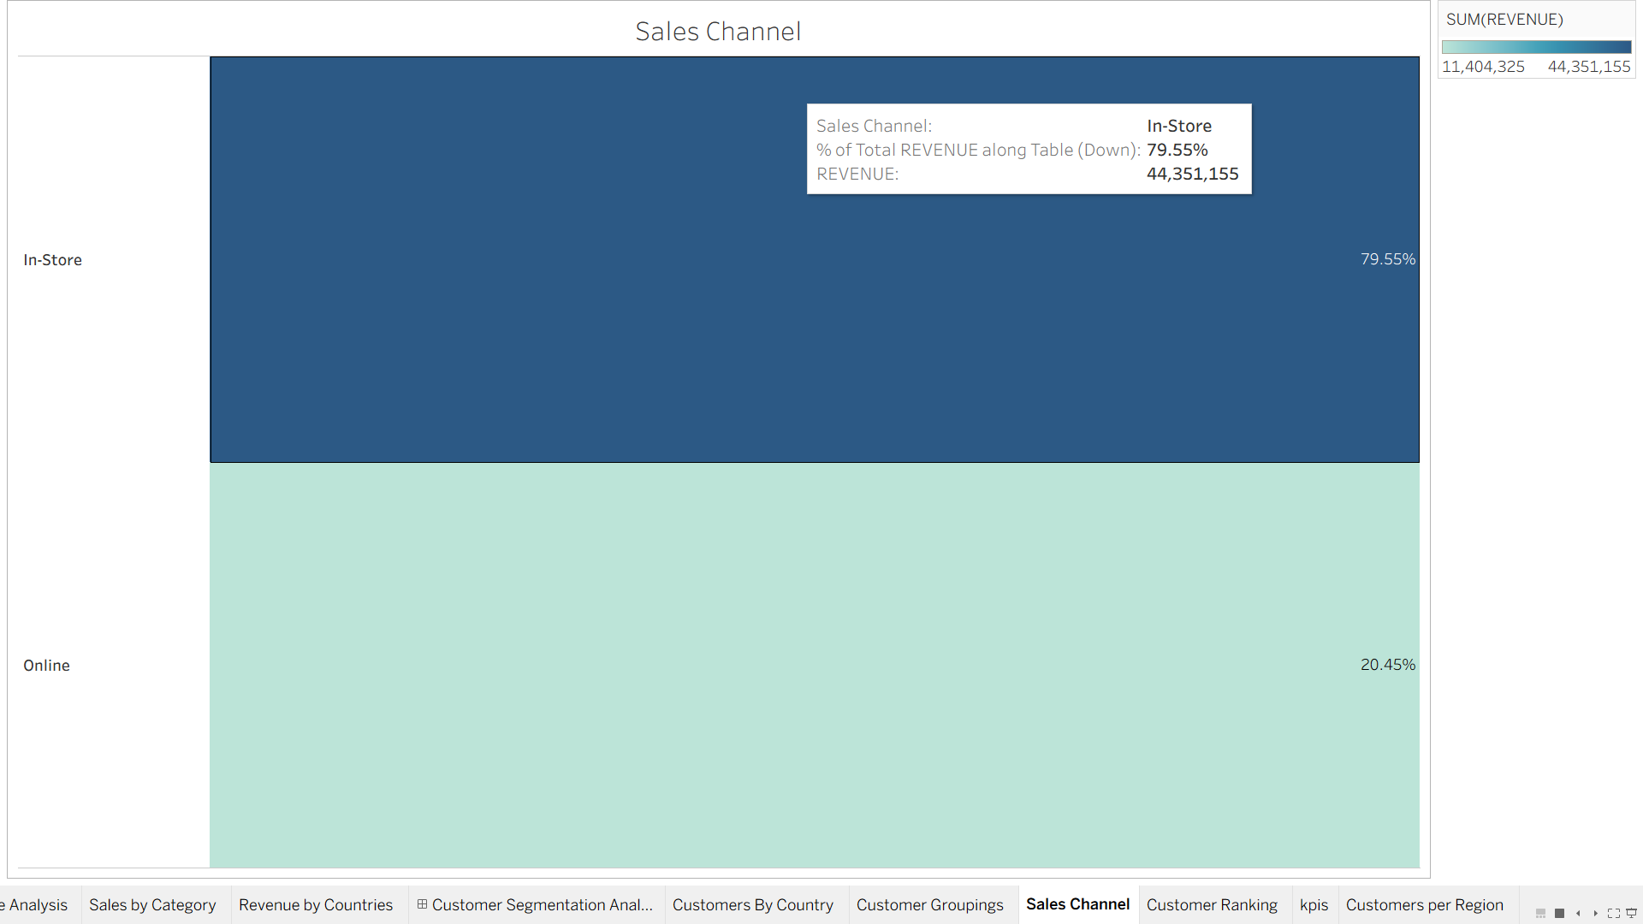
REVENUE AND PROFITABILTY ANALYSIS
KEY FINDINGS
More revenue was obtained from goods bought in store than those bought online, stores contributed 44.34M while online sales were 11.4M

Slide 9
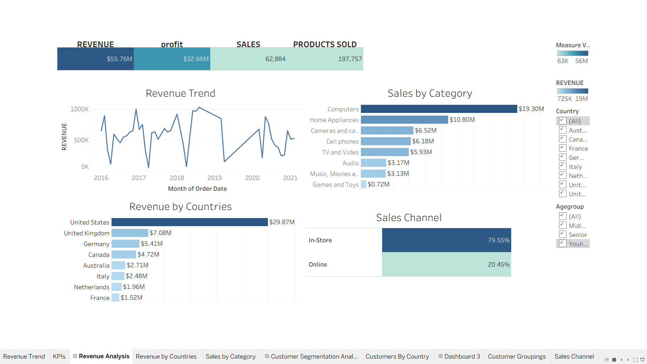
REVENUE AND PROFITABILITY DASHBORD

Slide 10
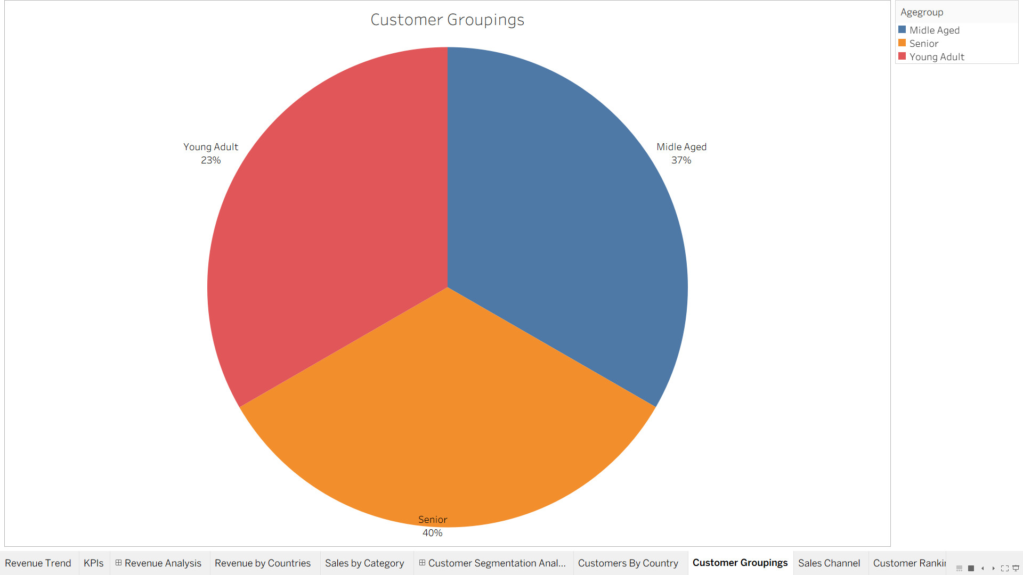
CUSTOMER SEGMENTATION ANALYSIS
KEY FINDINGS
Senior and Middle-aged customers account for 76.8% revenue suggesting a loyal, higher spending demographic that should be targeted for premium product marketing

Slide 11
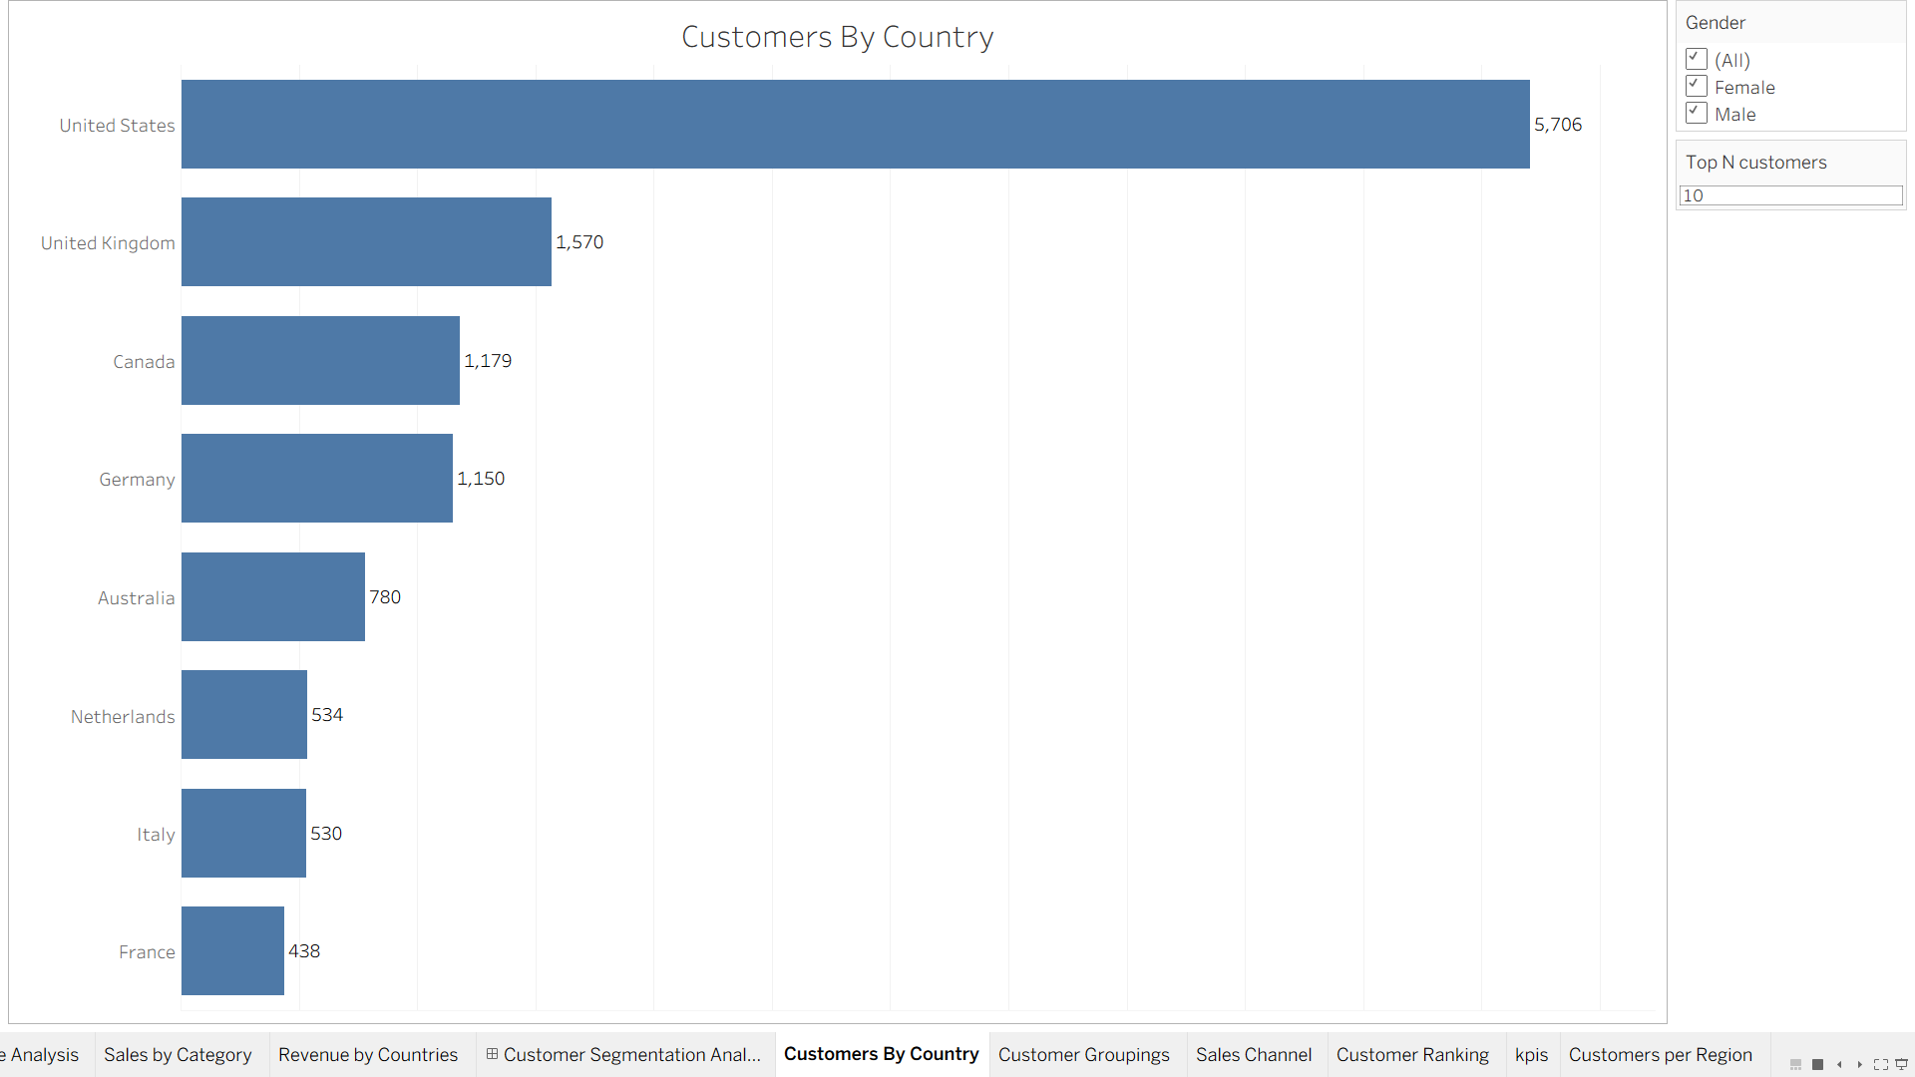
CUSTOMER SEGMENTATION ANALYSIS
KEY FINDINGS
The united states is by far the highest largest market contributing almost half of the revenue with 6885 customers

Slide 12
CUSTOMER SEGMENTATION ANALYSIS
The total number of customers was 11,887 with an average spending of 4.69k USD , with an average order of 2 items per customer
Revenue is almost evenly split between male and female customers indicating gender neutral appeal of the product range
KEY FINDINGS

Slide 13
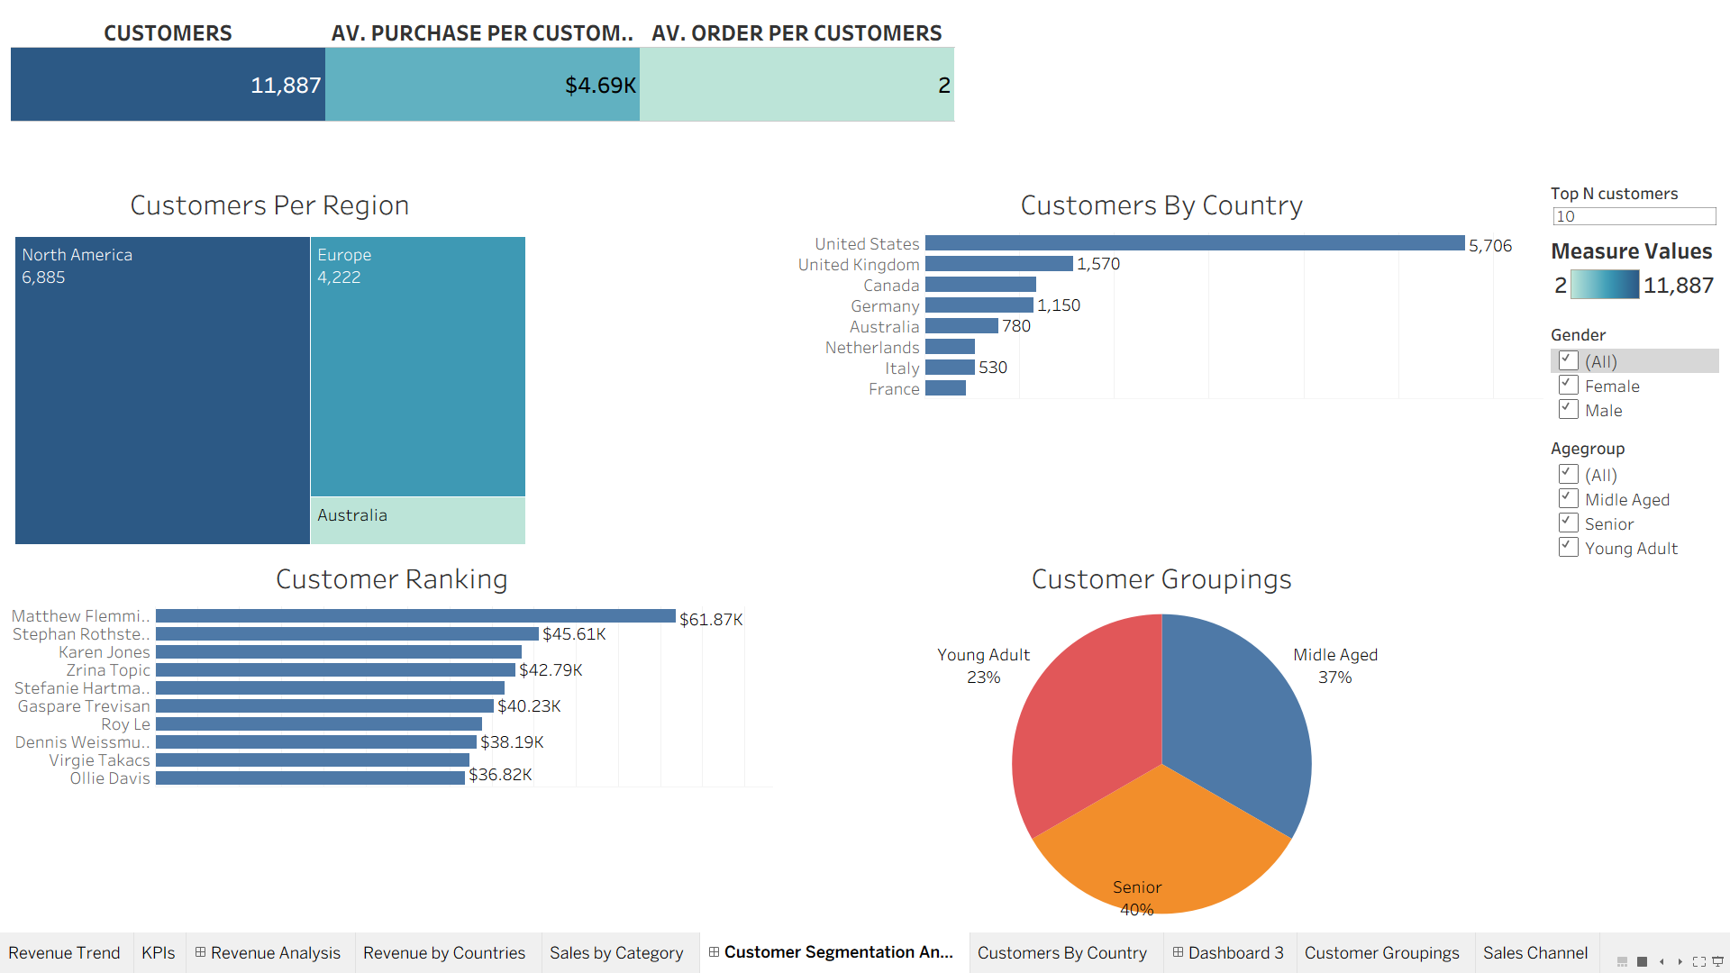
CUSTOMER SEGMANTATION ANALYSIS

Slide 14
Key Recommendations
1.Grow the online channel
With only 20.5% of revenue online, investing in e-commerce ux, digital marketing and same day delivery can significantly increase revenue without requiring additional physical stores
2.Expand geographic foot print
Reduce dependency on the US market, Australia and Southern Europe (Italy)show growing demand and offer expansion opportunities
3.Target Senior Segment
Seniors generate more revenue, design dedicated loyalty programs, easier to use product lines and in store assistance program to retain growth
4.Invest in high margin category items
Cameras &amp; Camcorders (60.1% margin) and TV &amp; Video (59.7% margin) offer superior returns. Allocate more floor space and targeted promotions to these categories.
5.Post-Pandemic Recovery Strategy
The sharp revenue decline in 2020-2021 warrants a focused recovery strategy: reactivation campaigns for dormant customers, aggressive pricing for high-demand products like laptops and home electronics (which surged during remote work/study).

Slide 15
Advanced Analysis that could be done
1.RFM Analysis for customer segmentation
2.Different exchange rates and its effect on the company's profit
3.Use of sets and more advanced parameters on tableau

Slide 16
THANK YOU
Data analytics capstone project may 2026

